Slide 1
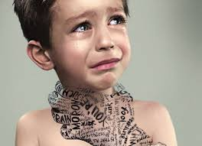
Relational Bullying
Lauren Wazio, Shanda Harclerode, Susan Nourse

Slide 2
WHAT IS RELATIONAL BULLYING?
The intent to harm someone by damaging their reputation or social relationships.
Relational bullying was one of the most common types of bullying that students experienced.

Slide 3
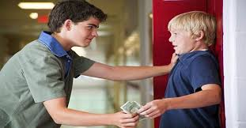
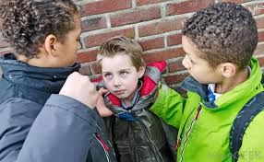
Bullying doesn’t always look like this...
Or this...

Slide 4
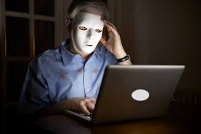
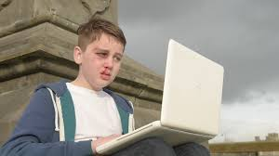
Cyberbullying
Bullying through social media
More than ⅓ of adolescents report being victims of cyberbullying
More than ½ of adolescents admit to engaging in cyberbullying
Both boys and girls engage in cyberbullying
Rise in popularity:
Widespread use of social media among adolescents
Lack of rules online
Anonymity
Advice for Victims:
Don’t respond to the message
Save the message and record date & time
Tell your parents
Notes:
Citation: Relational Aggression in School Settings: Definition, Development, Strategies, and Implications Alicia L. Dailey, Andy J. Frey, and Hill M. Walker
And
The causes and nature of bullying and social exclusion in schools

Slide 5
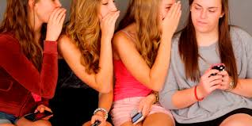
Gossip & Rumors
Used to establish and maintain social power
Group think mentality
Targets are often perceived as a threat to a group
Notes:
Citation: Rumors And Gossip As Forms Of Bullying: Sticks And Stones? Christine C. Kieffer, Ph.D., ABPP

Slide 6
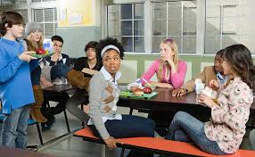
Exclusion
Begins at a young age
Establish power by denying an individual’s need to belong
We vs. Them
“You can’t sit here”
“You can’t play with us”
Notes:
Citation: http://news.jrn.msu.edu/bullying/2012/03/27/a-new-bullying-social-exclusion/

Slide 7
How can you identify bullying?
Understand what bullying is
Verbal, physical, social, cyber, etc
Systematic and recurring
The bullying represents a power in balance.
Victim loses because they’re smaller, unable to cope, etc.
Harm done is intentional
Understand what bullying is not
Child’s play
Everyday arguments

Slide 8
Identifying the bully vs the victim
Bully
Strong needs to be dominant; superior
May have a physically stronger appearance
Easily angered; impulsive
Engage in antisocial behaviors at early age
Considered to be average in popularity, but typically have peers that side with them
Victim
May have bruises, injuries; possessions may be damaged
Commonly chosen last for group activities
May appear distressed, unhappy; retract from previously liked activities.
Commonly picked on and unable to defend themselves
May be found alone or excluded from groups
Notes:
http://www.kzoo.edu/psych/stop_bullying/for_teachers/identifying.html

Slide 9
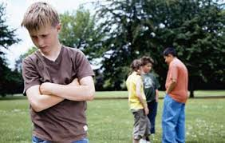
Identification can be difficult
Individuals can both bully and be bullied, even within the same interaction
Bullying can occur within friendships
Bullies can be boys or girls
Notes:
Citation: CJ Pascoe, Notes on Sociology of Bullying and
The causes and nature of bullying and social exclusion in schools

Slide 10
Why does bullying occur?
The social construct of desirable characteristics
White
Thin
Male
Heterosexual
Christian
Financially Secure

Slide 11
Power is maintained by bullying those that are different
The Other
Poor
Gay
Ideal Characteristics
Thin
White
Male

Slide 12
Who is targeted?
According to the NEA Survey, Educators reported that students were targeted because
Their weight (23%)
Their gender (20%)
Their perceived sexual orientation (18%)
Their Disabilities (12%)
There have also been increasing reports of religious based bullying.

Slide 13
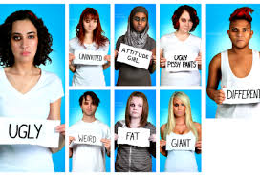
Identifying those at-risk
Some relational bullying prevention programs target at-risk students including
Girls
Minorities
Low-income, urban settings
Notes:
Citation: Relational Aggression in School Settings: Definition, Development, Strategies, and Implications Alicia L. Dailey, Andy J. Frey, and Hill M. Walker

Slide 14
Bullying Assessment
-The majority of the school practitioners and counselors have received training on bullying in comparison to school psychologists.
-Training components were more likely to address types of bullying as well as the consequences for those who were involved.
-In comparison to school psychologists, counselors are reported to be more involved in bullying assessments.
-Some practitioners assess bullying through evidence based rating scales.
Notes:
http://pralab.tamu.edu/documents/How_do_schools_identify_bullying.pdf

Slide 15
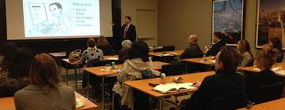
The Role of the School Administrator
Set the tone of your school’s atmosphere
Increase adult supervision
Be active in raising support for bullying prevention
Provide training for teachers on prevention and proper intervention
Respond appropriately and consistently to bullying
Establish and enforce clear rules about bullying
Spend time talking with students and teachers about bullying
Continuous effort over time.

Slide 16
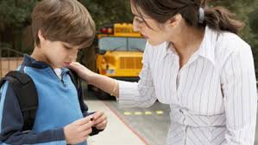
The Role of the Teacher
Be familiar with the definition and types of bullying
Utilize appropriate strategies
Promote and reward positive social behaviors
Provide students with clear expectations
Give students opportunities to practice empathy
Do not ignore bullying
Don’t rely solely on referral to another authority
Separate students involved in aggressive situations
Encourage class discussion regarding bullying
Notes:
Citation: Jina Yoon Sheri Bauman Teachers: A Critical But Overlooked Component of Bullying Prevention and Intervention

Slide 17
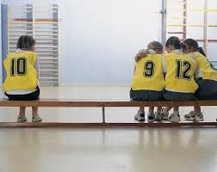
The Role of the Coach
Be familiar with bullying policies within your school or organization
Communicate with parents
Identify existence of special needs, be alerted to children that may be at-risk for bullying
Document bullying incidents
Be a model for good sportsmanship
Utilize cooperation rather than competition
Pay attention to what is going on
Reduce or eliminate unstructured time
Divide cliques that form into mixed groups
Notes:
Citation: Bullying in Recreation and Sport Settings: Exploring Risk Factors, Prevention Efforts, and Intervention Strategies Charlene S. Shannon

Slide 18
Ways to Inform the Community about Bullying
Educational awareness programs
Gather support from outside organizations, sponsors, churches to help support the prevention of bullying
Notes:
http://onlinedegreesineducation.org/2012/how-great-teachers-can-identify-and-prevent-bullying-in-schools/

Slide 19
Ways to prevent/respond to Relational Bullying
Available counseling/tutoring sessions for victims
Hold bullies accountable
Serve detention hours
Community service hours
Notes:
http://onlinedegreesineducation.org/2012/how-great-teachers-can-identify-and-prevent-bullying-in-schools/

Slide 20
